Slide 1
Data Visualization - A3
By- Akanksha (DT2023001), Ketki Bhatia (DT2023007), and Niharika Suri (DT2023015)
GROUP-DIGITAL SOCIETY

Slide 2
Table of Content
PART | DESCRIPTION
1 | 2019 Fraud Analysis
2 | 2019 (A3) vs 2020 (A1) Comparison
3 | Knowledge to Data (A1 to A3)
4 | Machine Learning

Slide 3
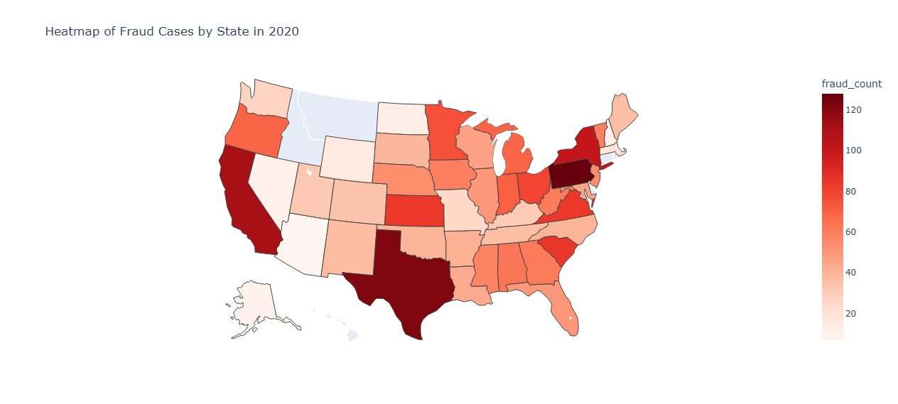
Heatmap of Fraud Cases (2020)

Slide 4
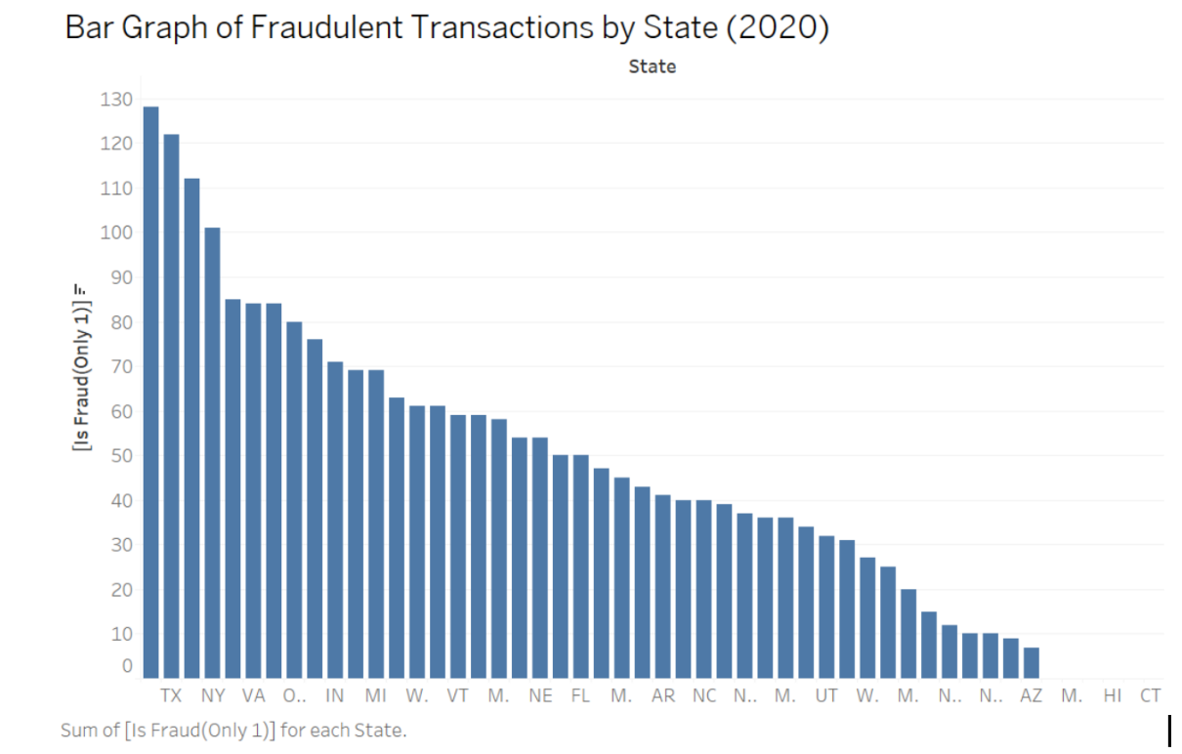
Bar Chart - Fraudulent Transactions by State (2020)

Slide 5
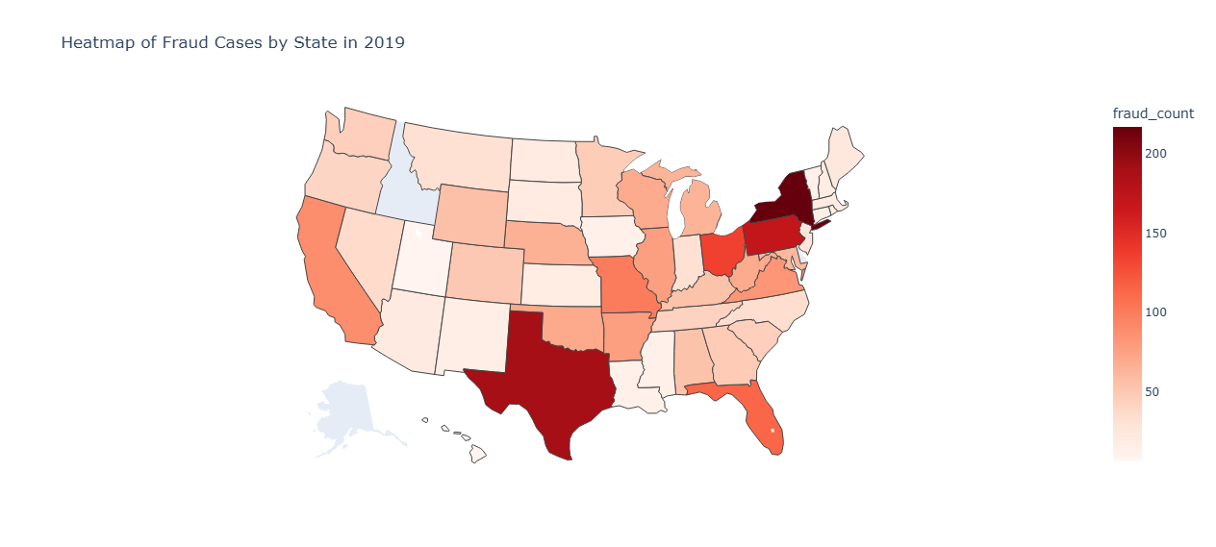
Heatmap of Fraud Cases (2019)

Slide 6
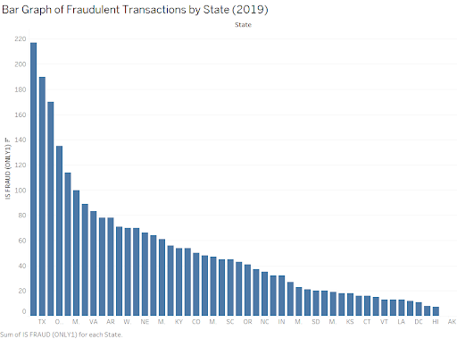
Fraudulent Transactions by State (2019)

Slide 7
States
High Fraud States of 2020
High Fraud States of 2019
PAVATXNYSCCA
PA TX
MOFL
NY
OH
TX
NY
PA

Slide 8
PART 1 - 2019 Analysis

Slide 9
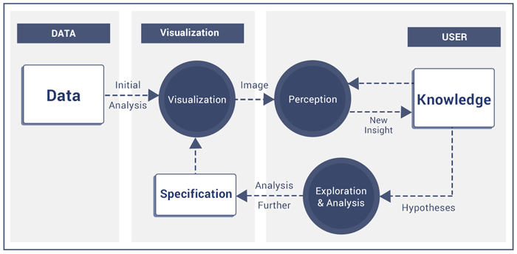
Data to Knowledge Loop

Slide 10
Loop 1
DATA
Fraud Status
Merchant Categories
High Fraud States
Cities
Job Categories
Generation

Slide 11
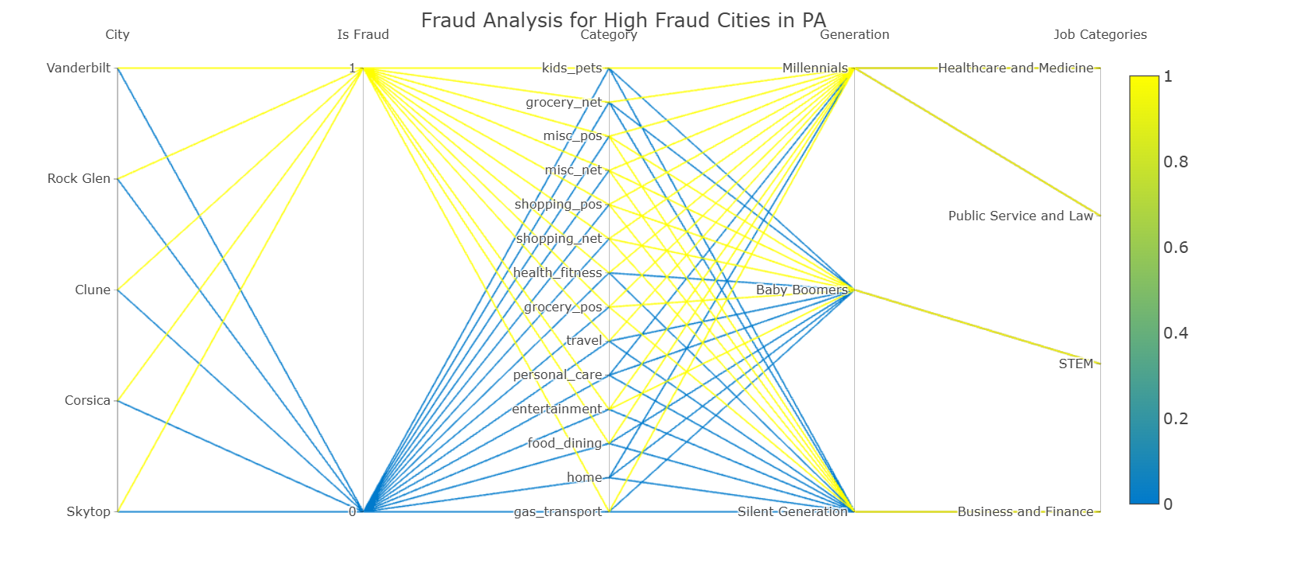
PCP for High Fraud Cities in PA 2019

Slide 12
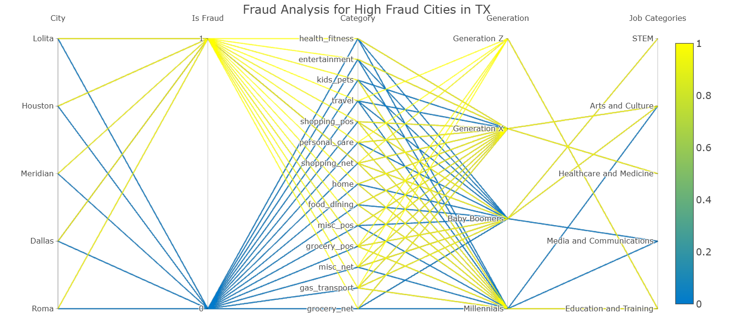
PCP for High Fraud Cities in TX 2019

Slide 13
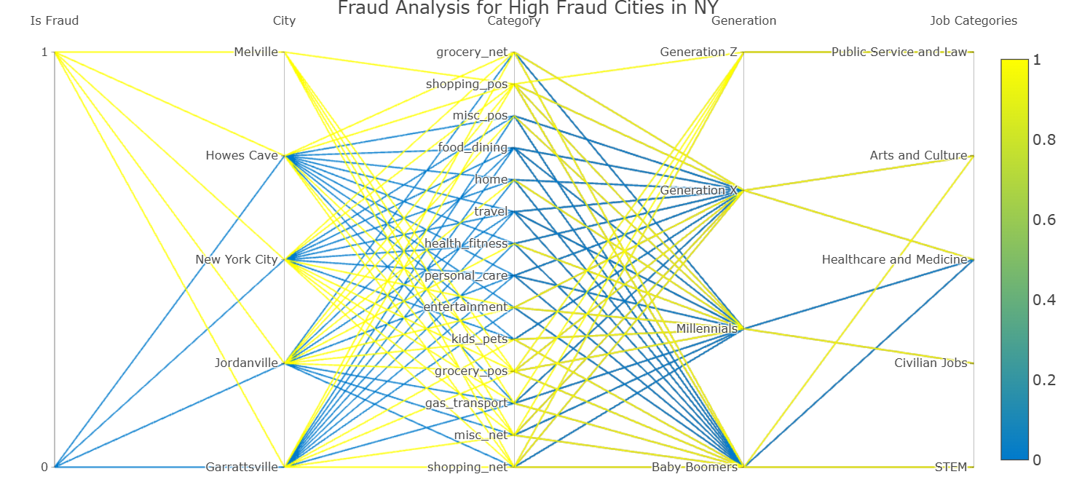
PCP for High Fraud Cities in NY 2019

Slide 14
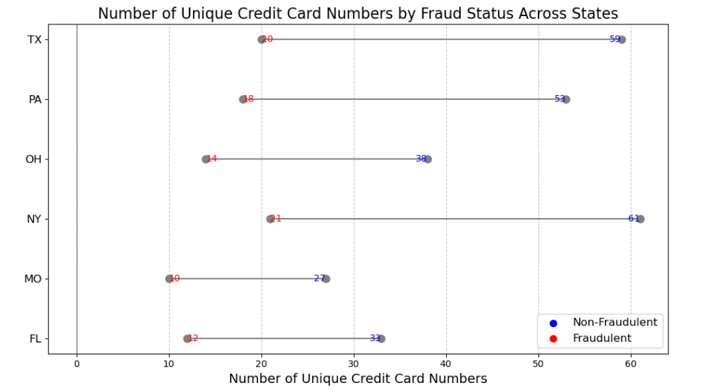
Dumbbell Chart for Unique CC Numbers by Fraud Across High Fraud States

Slide 15
Loop 2
DATA
Fraud Status
Job Categories
Common Fraud States
Transaction Hour
Transaction Month

Slide 16
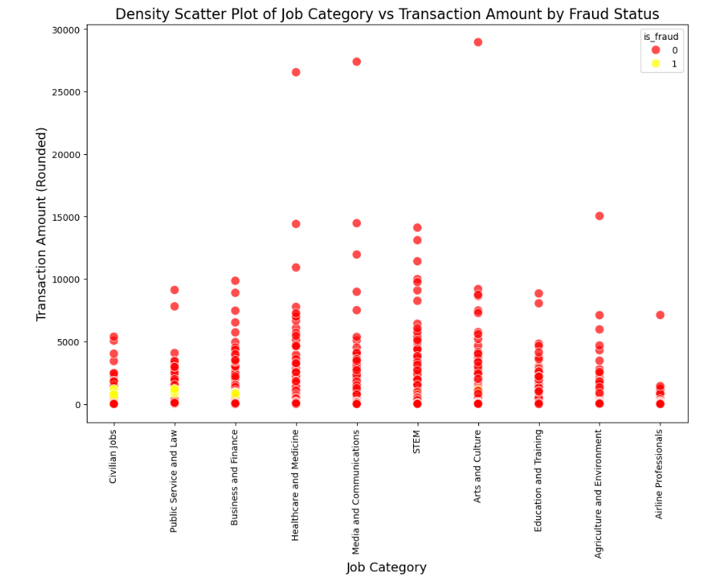
Density Scatter Plot of Job Categories vs Transaction Amount by Fraud Status

Slide 17
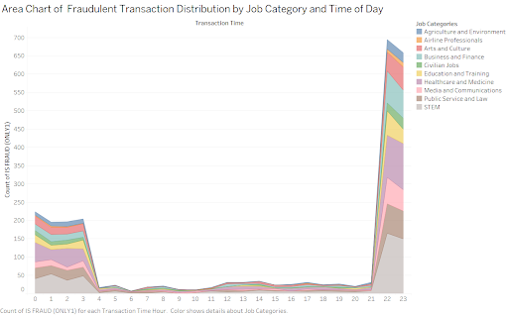
Area Chart (Transactions Over 24 Hours for different Job Categories)

Slide 18
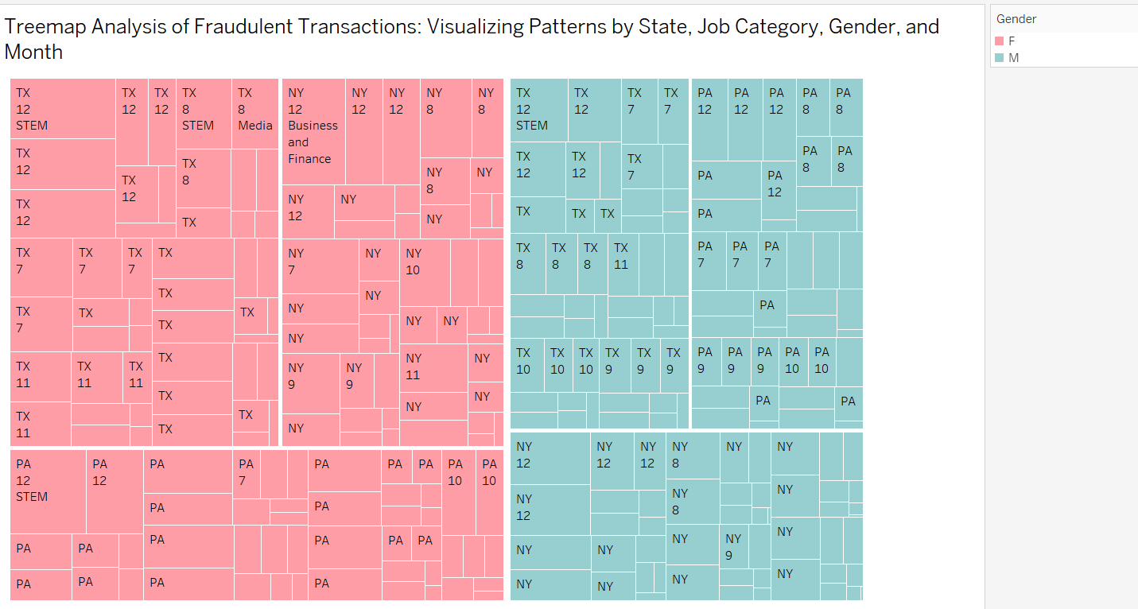
Treemap (Fraudulent Transactions by Common State, Gender, and Job Category)

Slide 19
Loop 3
DATA
Fraud Status
Merchant Categories
Common Fraud States
Transaction Hour
Transaction Month

Slide 20
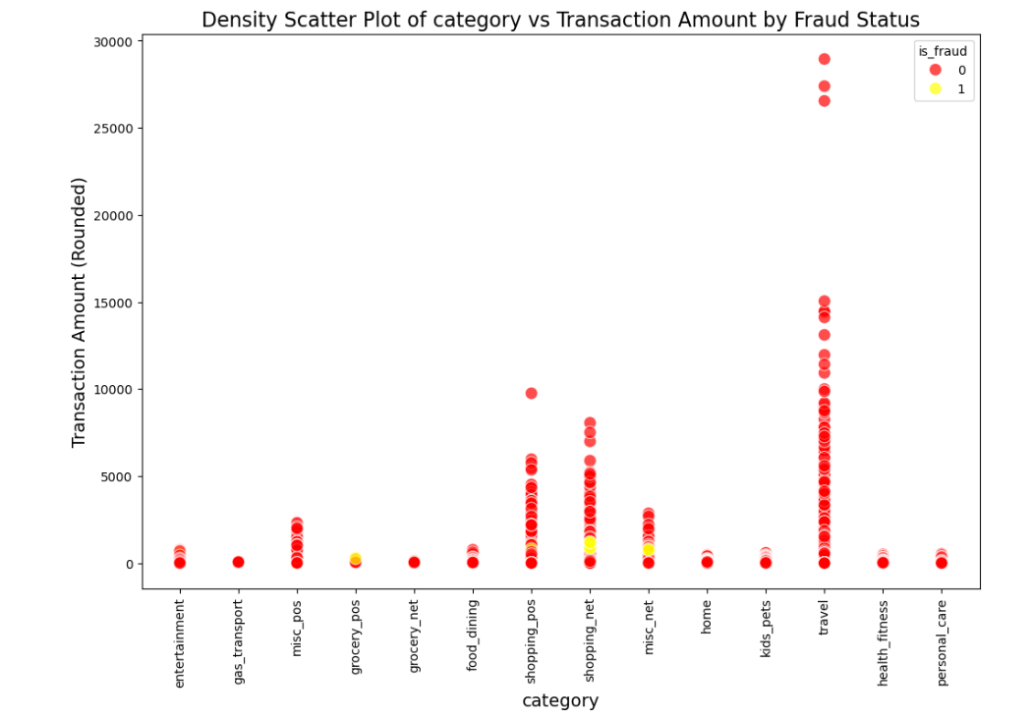
Density Scatter Plot of Merchant Category vs Transaction Amount by Fraud Status

Slide 21
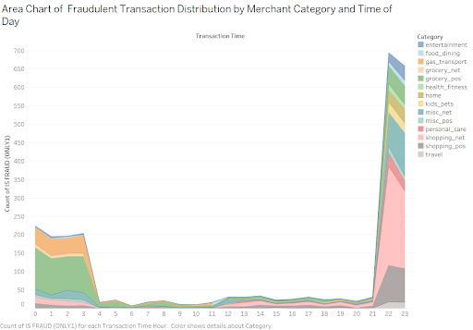
Area Chart (Transactions Over 24 Hours for different Merchant Categories)

Slide 22
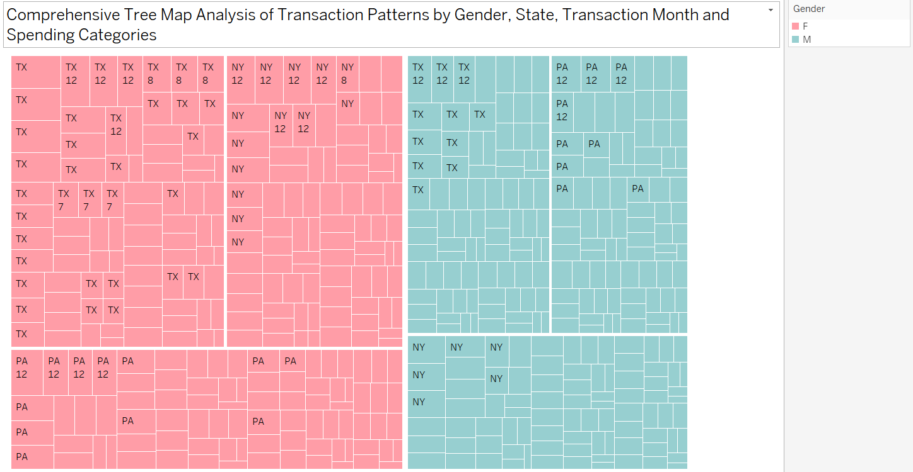
Treemap (Fraudulent Transactions by State, Gender, and Merchant Category)

Slide 23
Loop 4
DATA
Fraud Status
Gender
High Fraud States

Slide 24
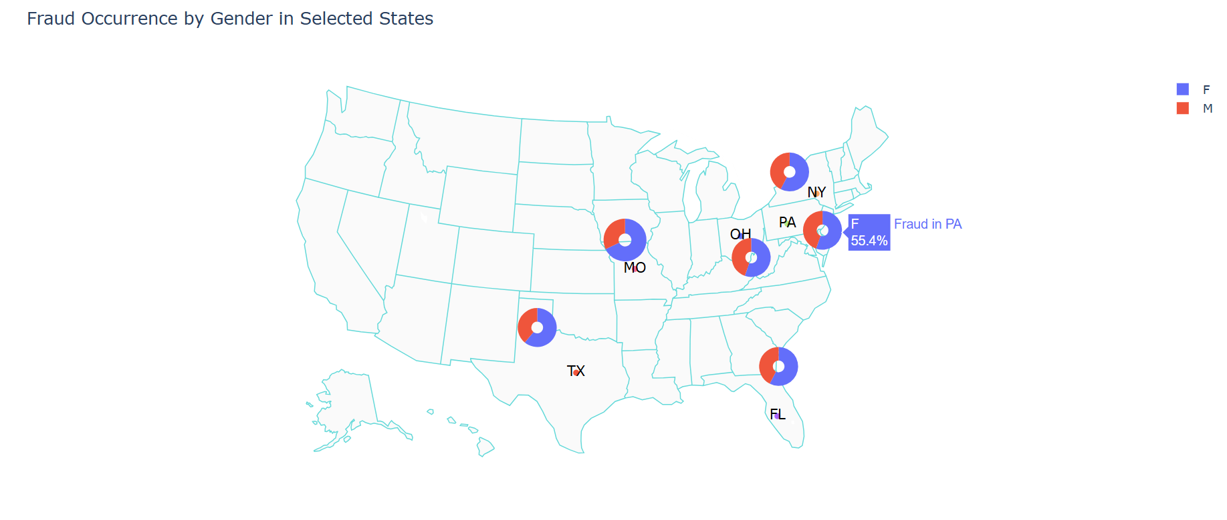
Donut Chart on USA Map (Fraud Distribution by Gender Across High Fraud States)

Slide 25
Loop 5
DATA
Transaction Hour
Common Fraud States
City

Slide 26
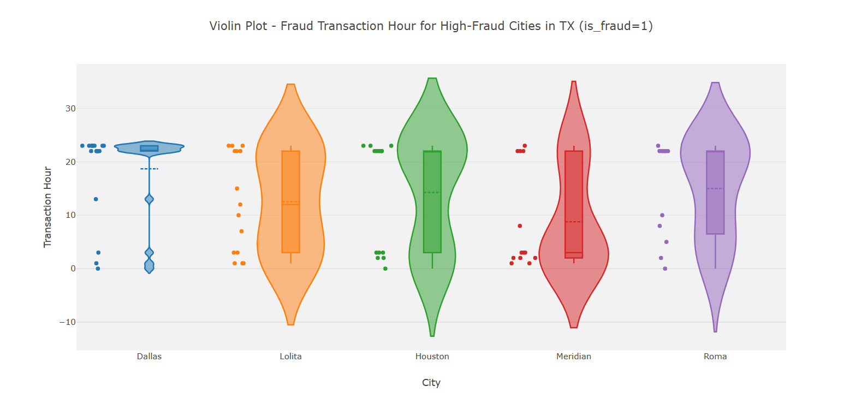
Violin Plot (Transaction Hour Distribution in High Fraud Cities - TX)

Slide 27
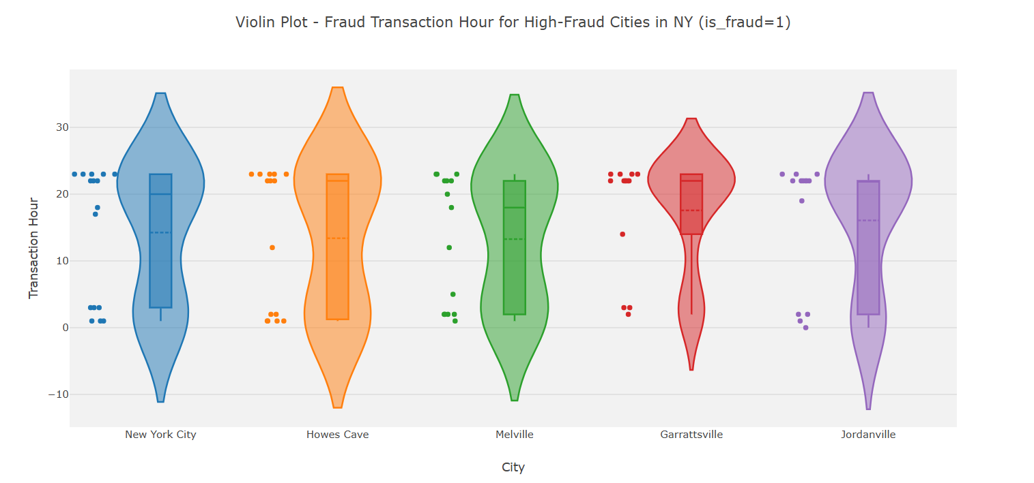
Violin Plot (Transaction Hour Distribution in High Fraud Cities - NY)

Slide 28
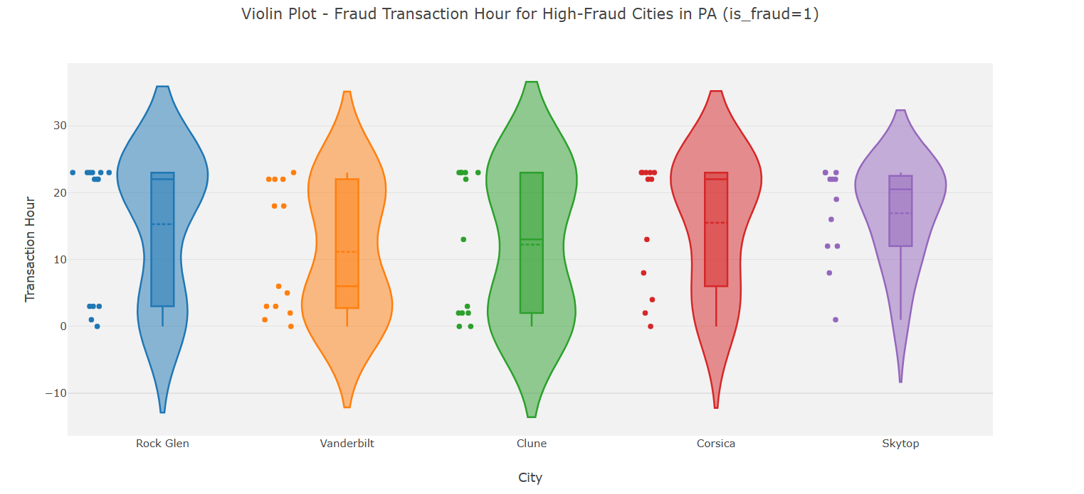
Violin Plot (Transaction Hour Distribution in High Fraud Cities - PA)

Slide 29
Loop 6
DATA
Transaction Amount
Common Fraud States
City

Slide 30
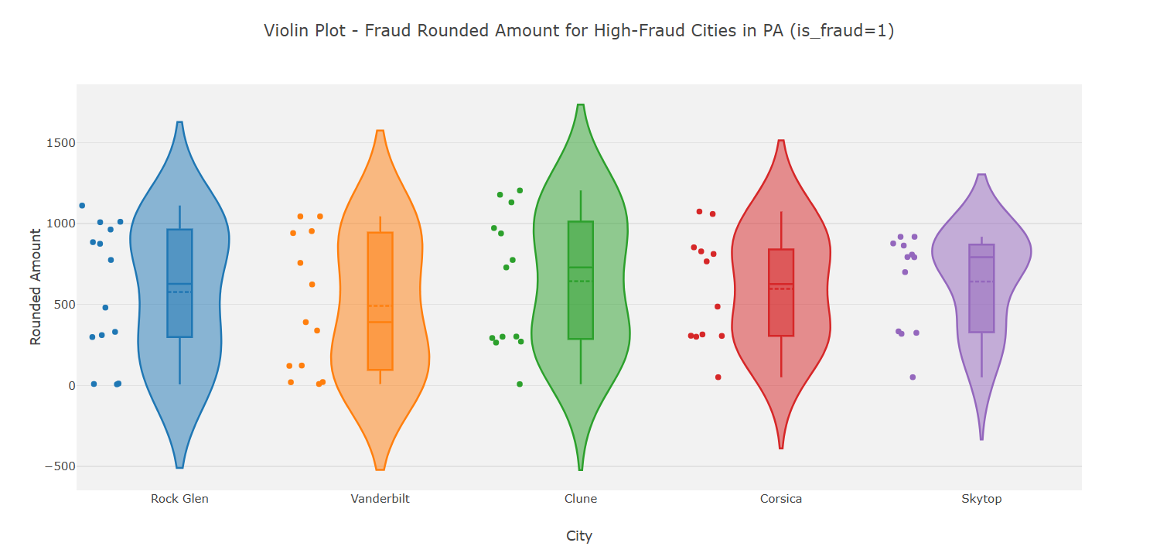
Violin Plot (Transaction Amount Distribution in High Fraud Cities - PA)

Slide 31
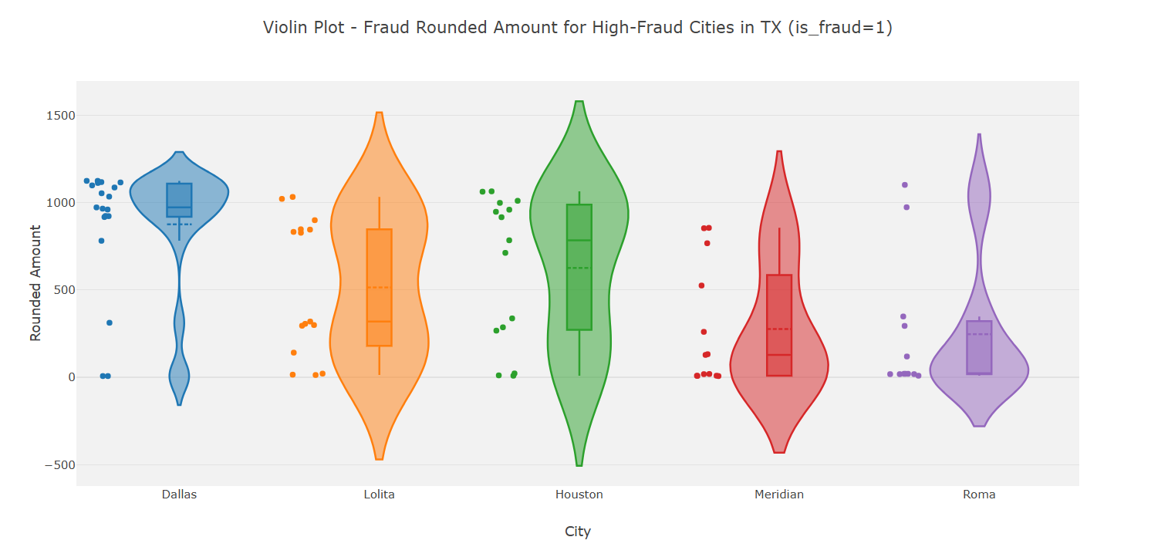
Violin Plot (Transaction Amount Distribution in High Fraud Cities - TX)

Slide 32
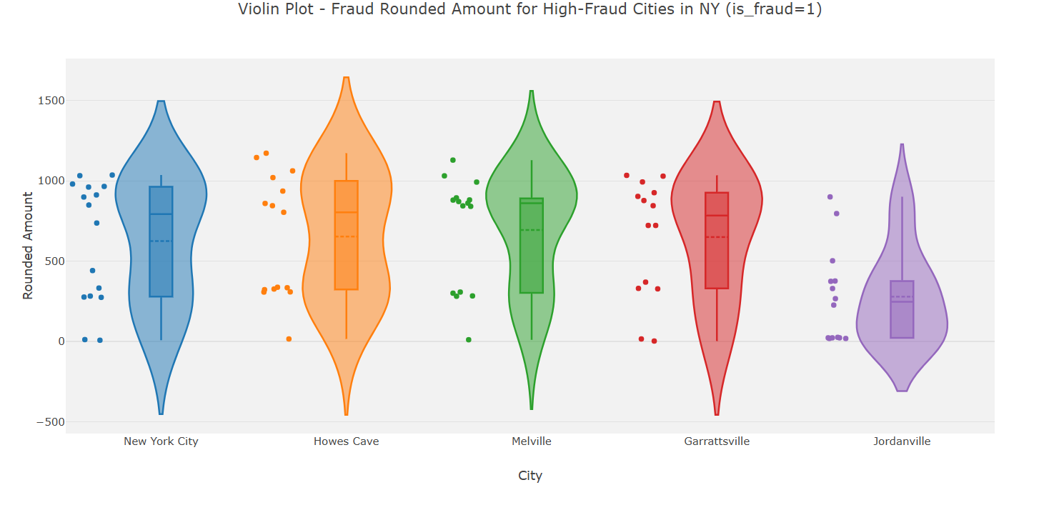
Violin Plot (Transaction Amount Distribution in High Fraud Cities - NY)

Slide 33
Loop 7
DATA
All Numerical Variable within the Dataset

Slide 34
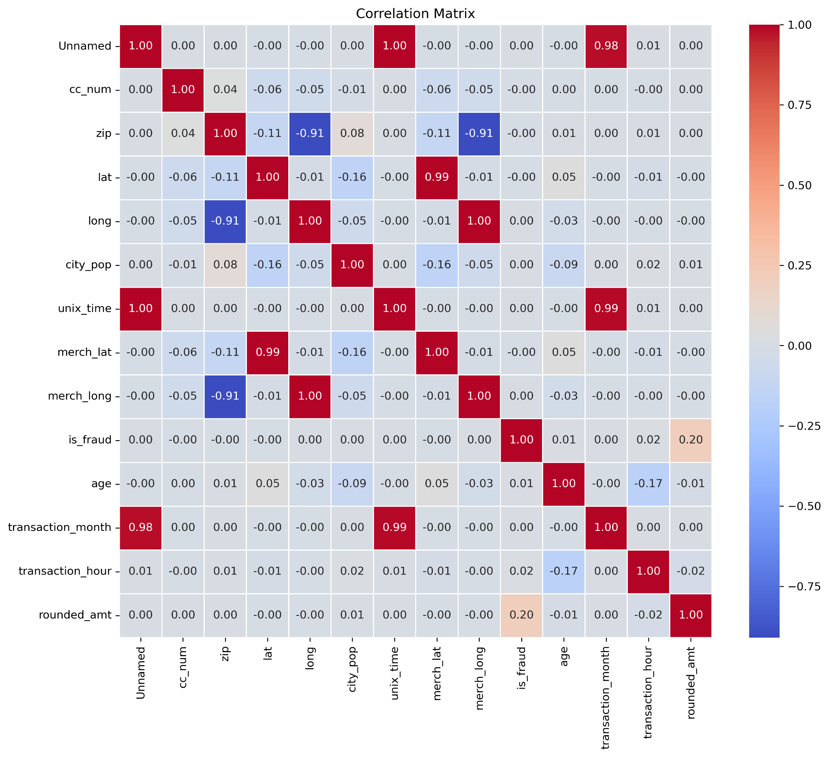
Correlation Matrix Heatmap (For all variables)

Slide 35
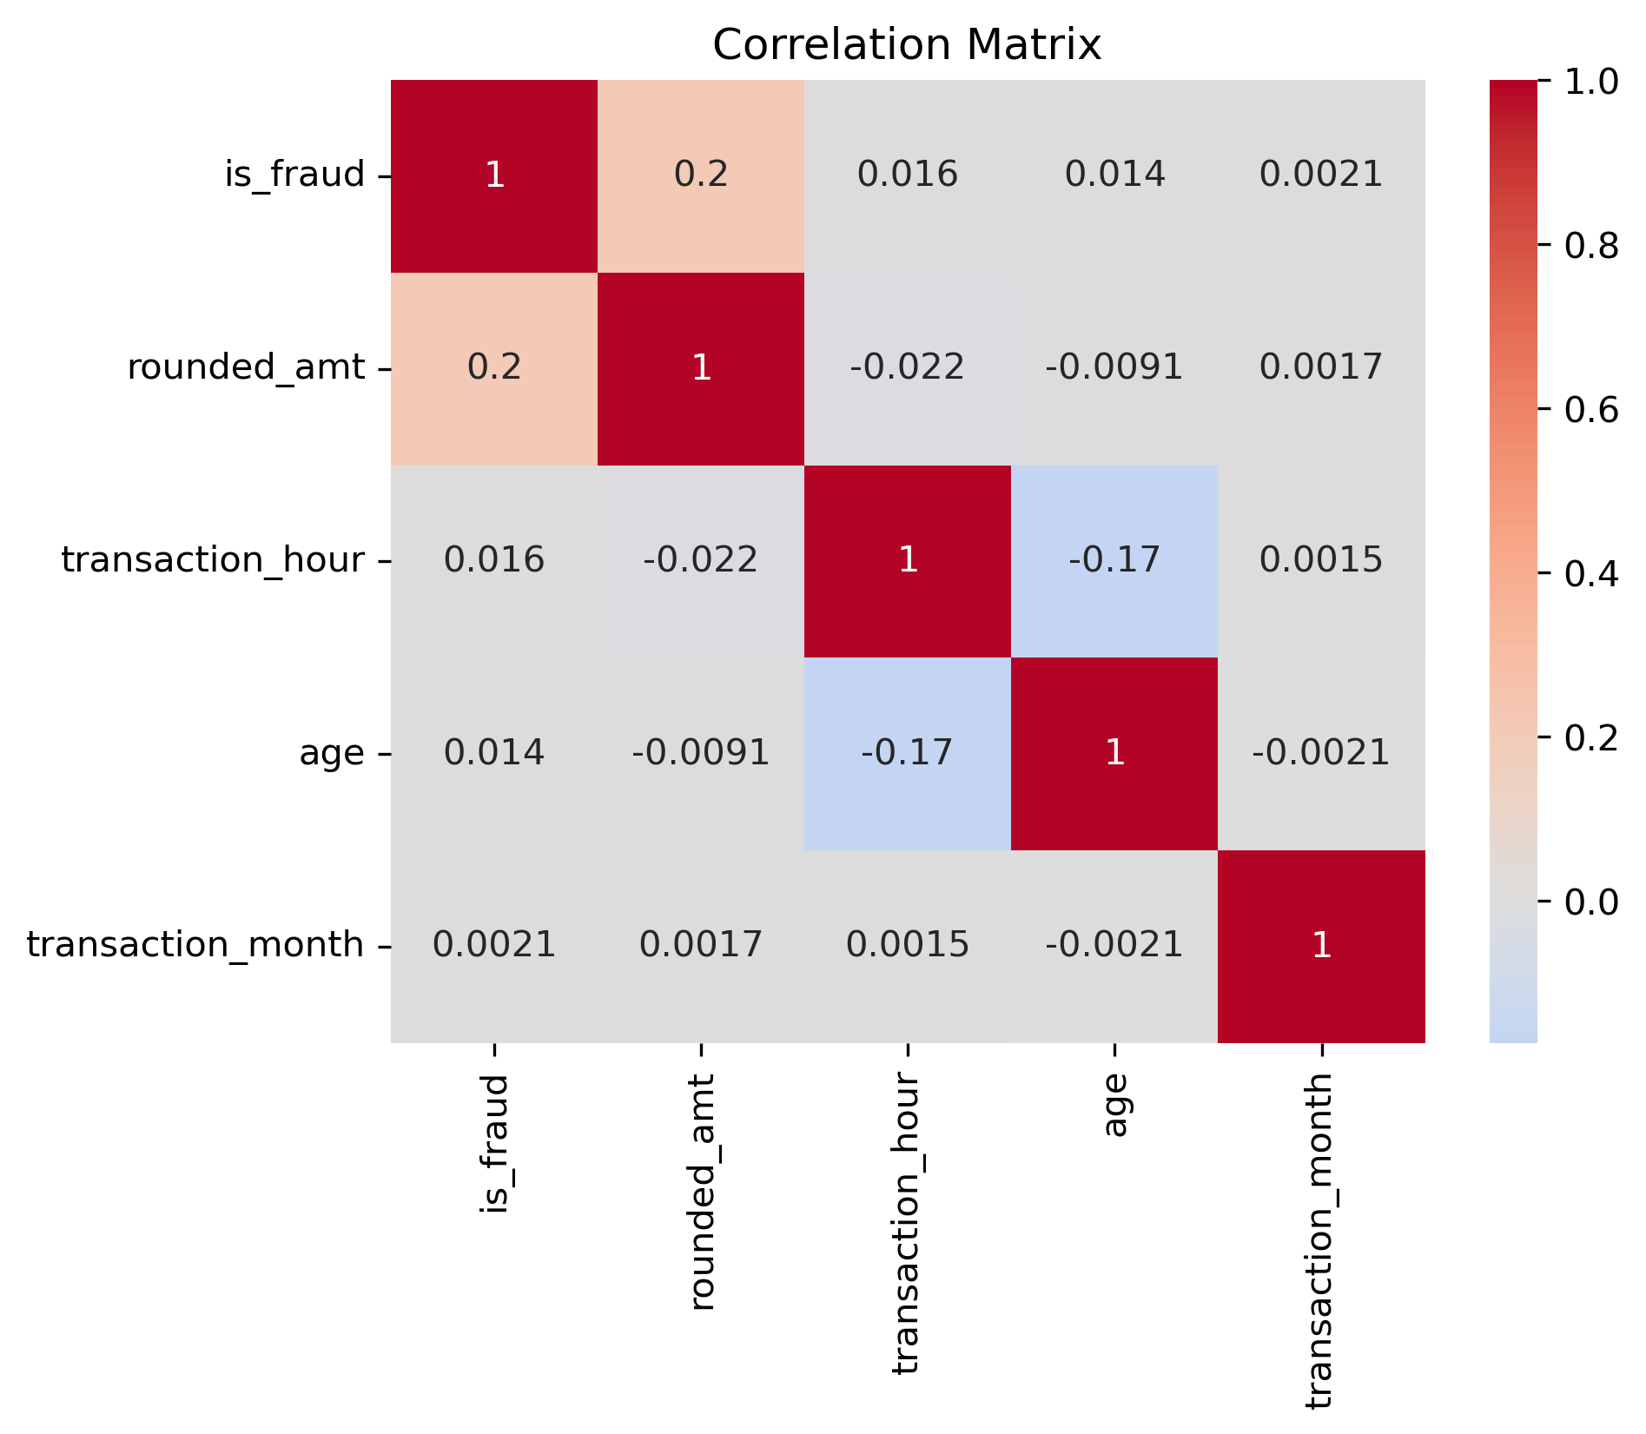
Correlation Matrix Heatmap (For specific variables)

Slide 36
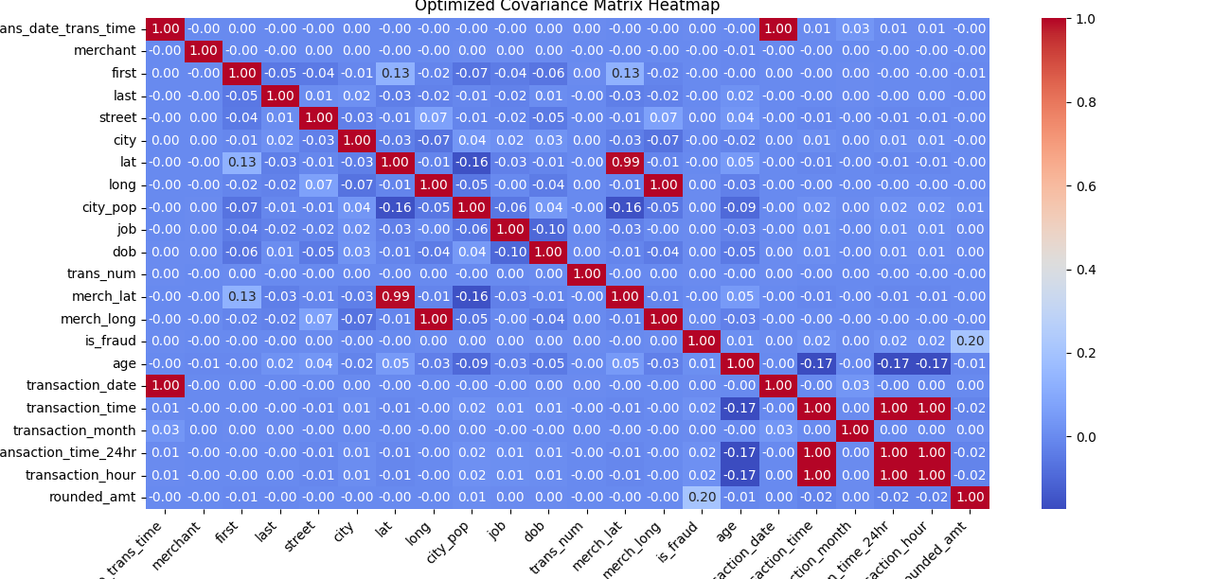
Covariance Matrix Heatmap (For all variables)

Slide 37
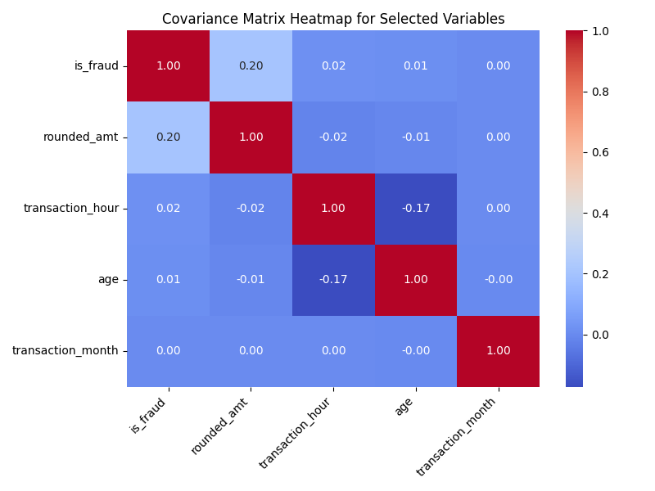
Covariance Matrix Heatmap (For specific variables)

Slide 38
PART 2 - 2019 & 2020 Comparative Analysis

Slide 39
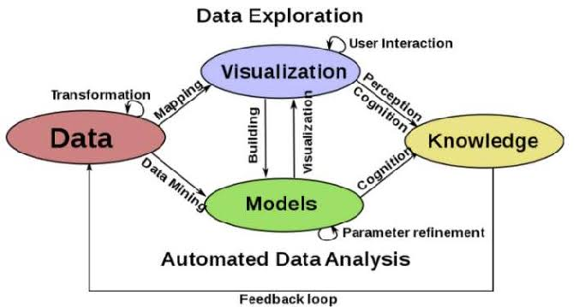

Slide 40
Loop 8
DATA
Fraud Status
Common Fraud States
Cities

Slide 41
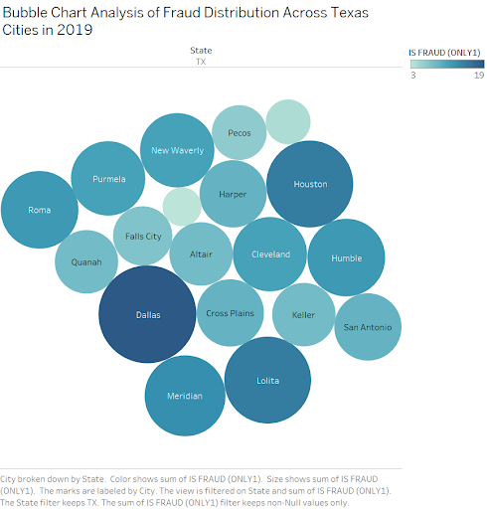
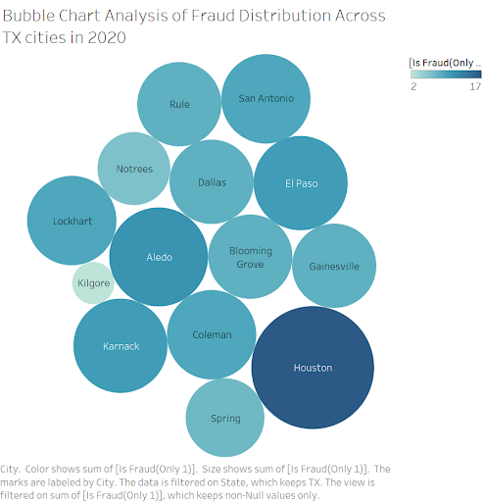
Texas Fraud cities in 2019 & 2020(3 common cities )

Slide 42
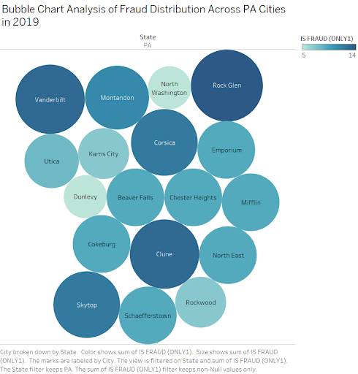
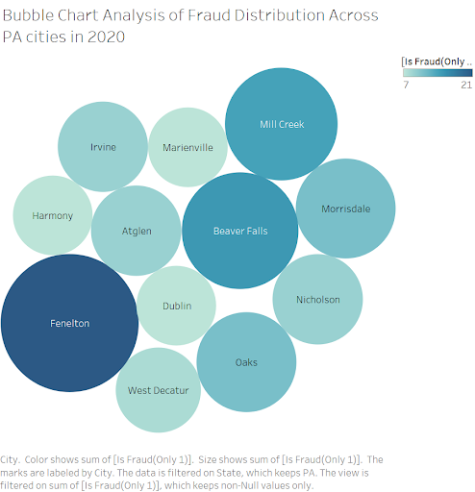
Pennsylvania Fraud cities in 2019 & 2020 (no common)

Slide 43
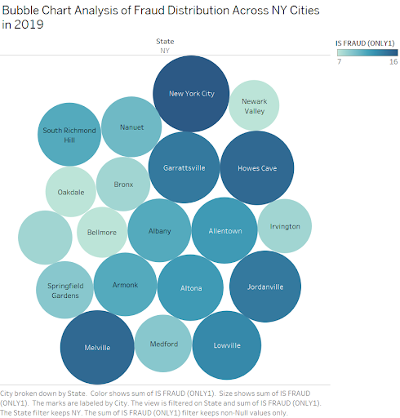
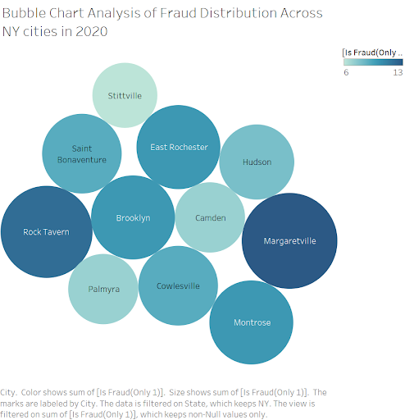
New York Fraud cities in 2019 & 2020 (1 common states)

Slide 44
Loop 9
DATA
Fraud Status
High Fraud States
Generation

Slide 45
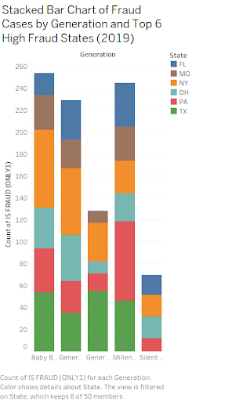
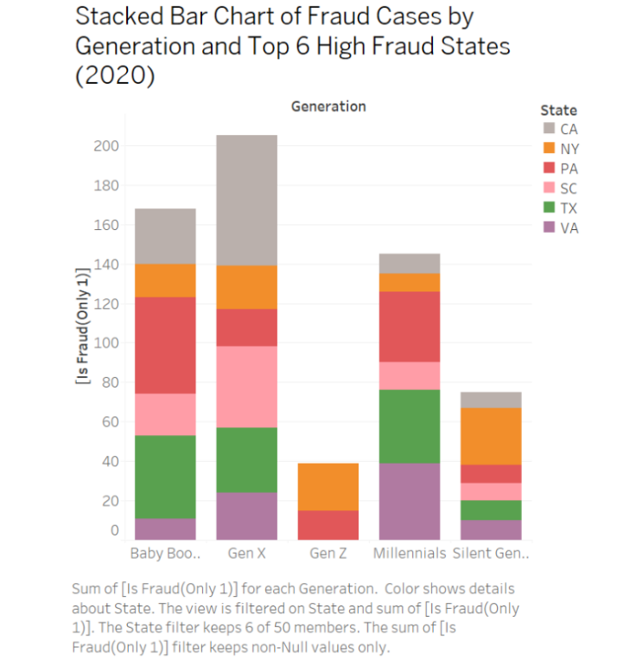
2019 & 2020 Stacked Bar Chart State, High Fraud States, and Generation

Slide 46
Loop 10
DATA
Fraud Status
Merchant Categories

Slide 47
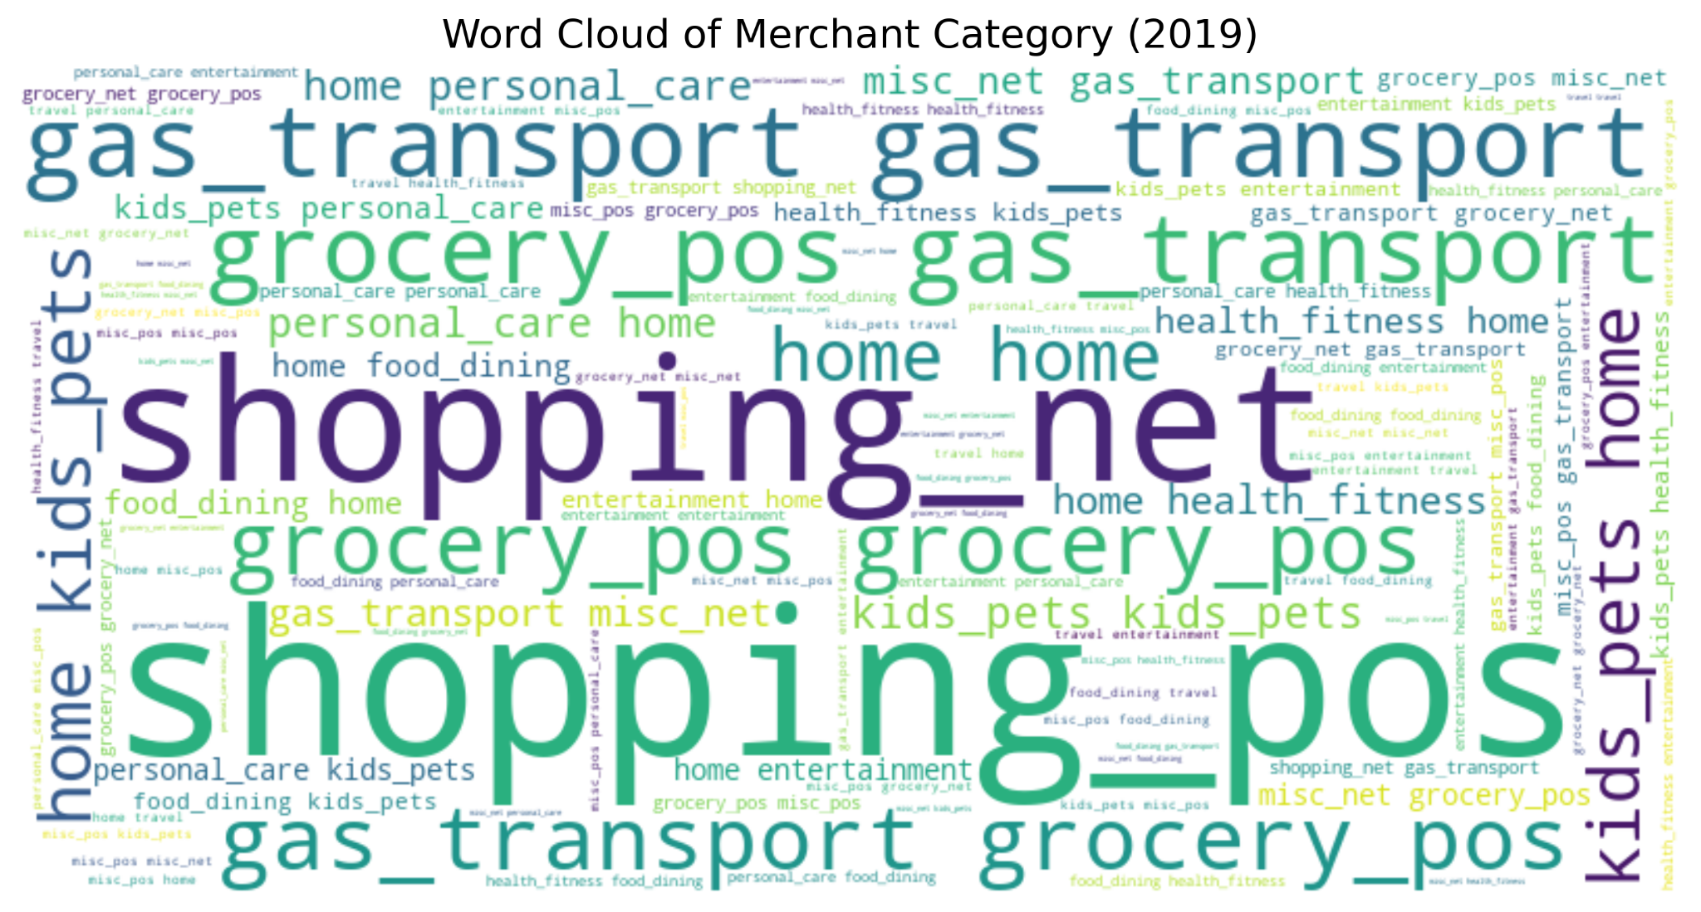
2019 Word Cloud for Merchant Categories and Fraud (1)

Slide 48
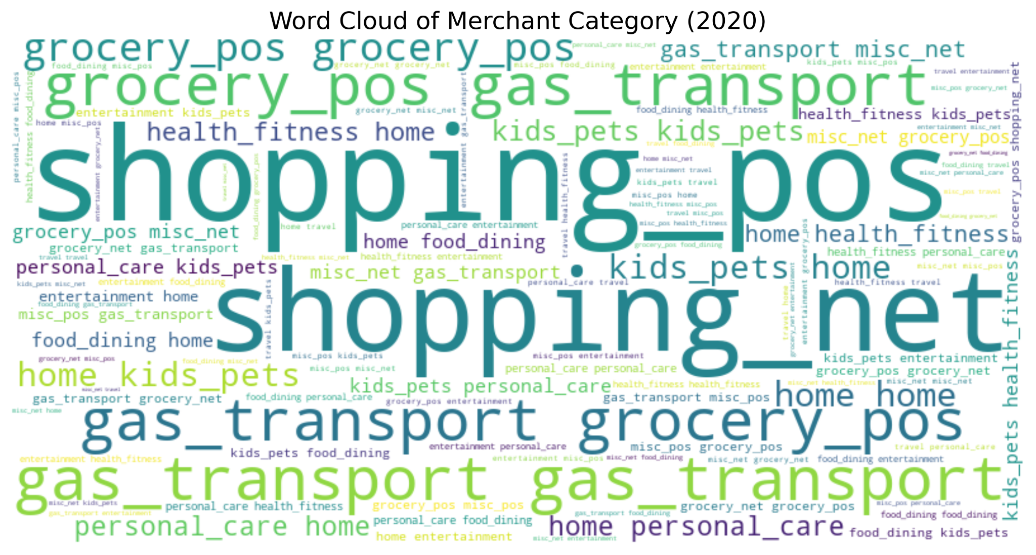
2019 Word Cloud for Merchant Categories and Fraud (1)

Slide 49
Loop 11
DATA
Fraud Status
Job Categories
Common Fraud States
Cities

Slide 50
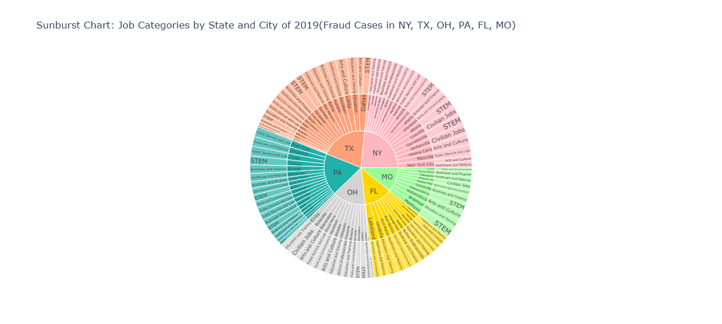
Sunburst Chart Job Categories by State, City 2019

Slide 51
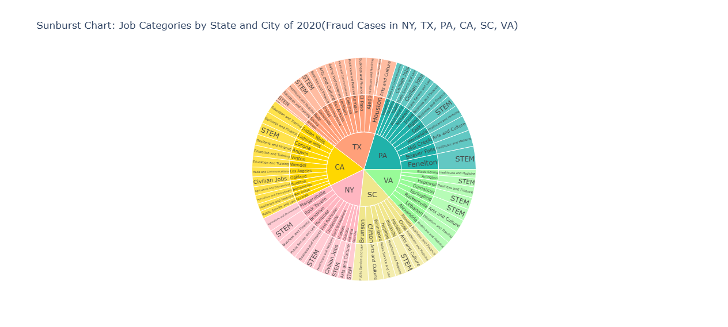
Sunburst Chart Job Categories by State, City 2020

Slide 52
Loop 12
DATA
Fraud Status
Rounded Amount

Slide 53
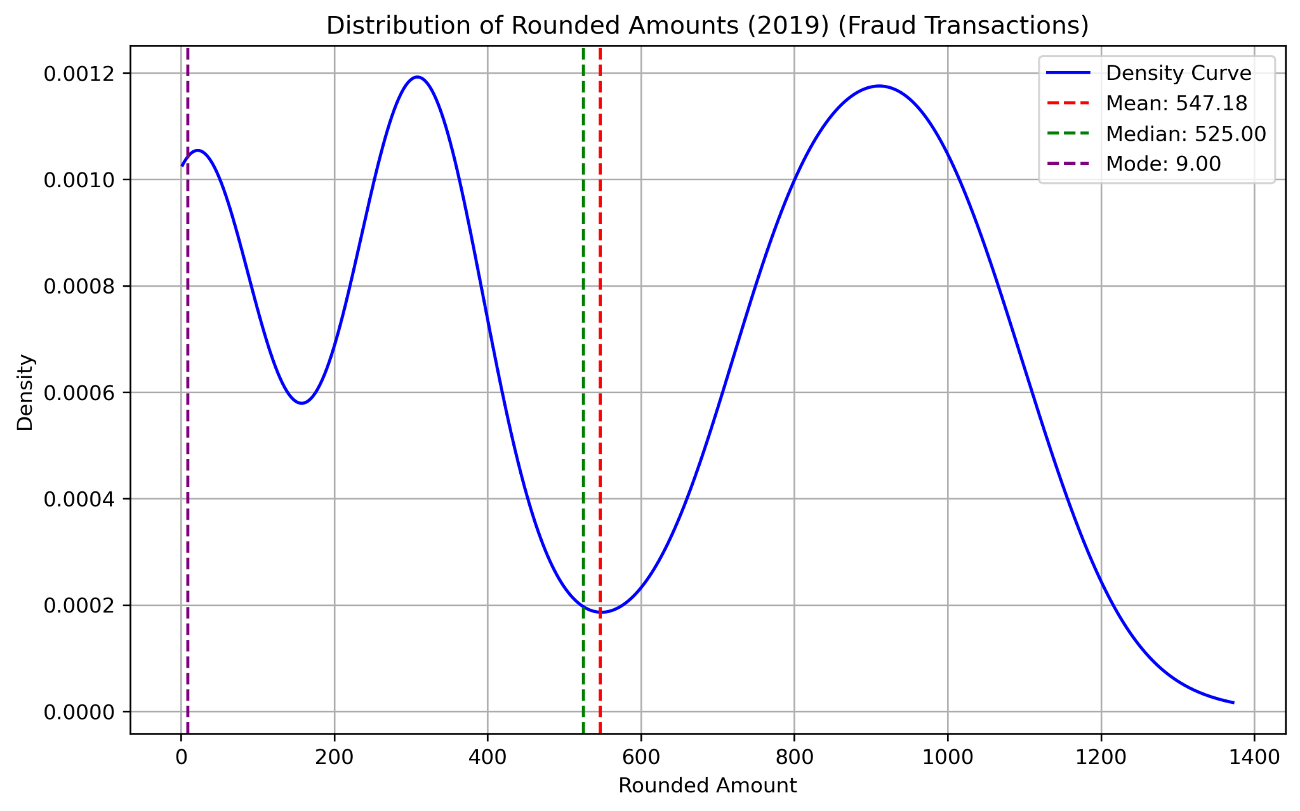
KDE of Fraudulent Transaction 2019

Slide 54
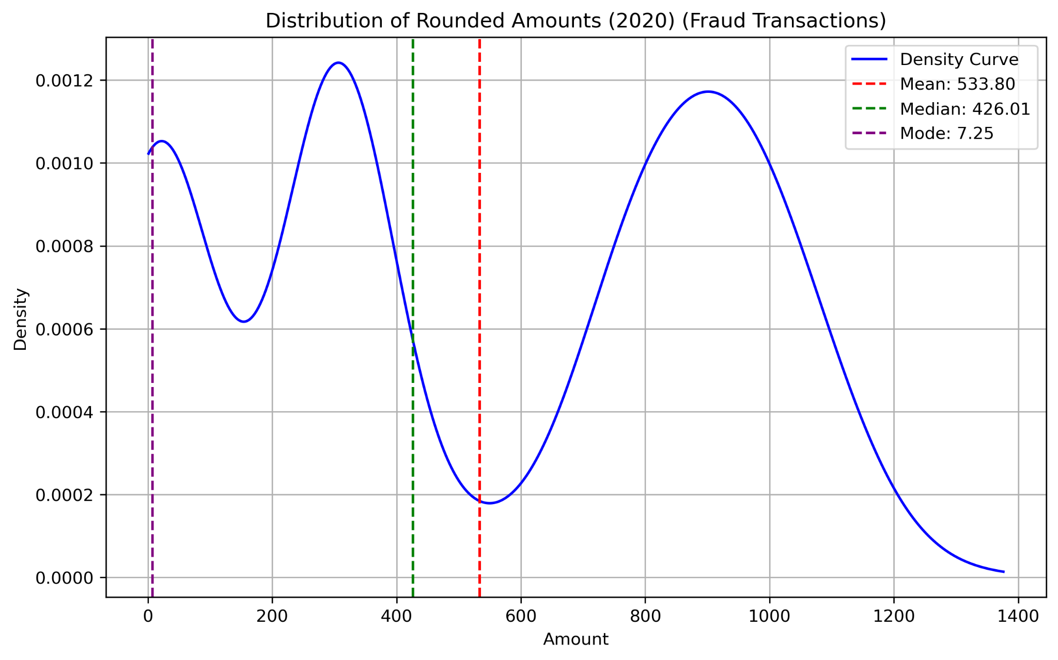
KDE of Fraudulent Transaction 2020

Slide 55
Knowledge to Data (A1 to A3)

Slide 56
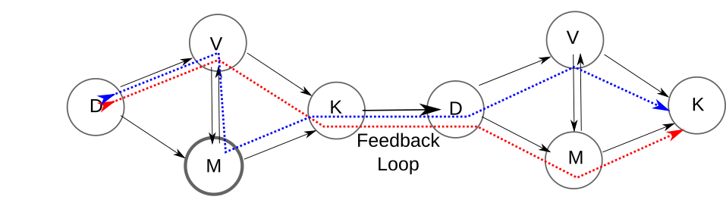

Slide 57
Loop 13
DATA
Fraud Per Victim
State Categories
Fraud Loss Amount
Fraud Victim Count
Transaction Hour

Slide 58
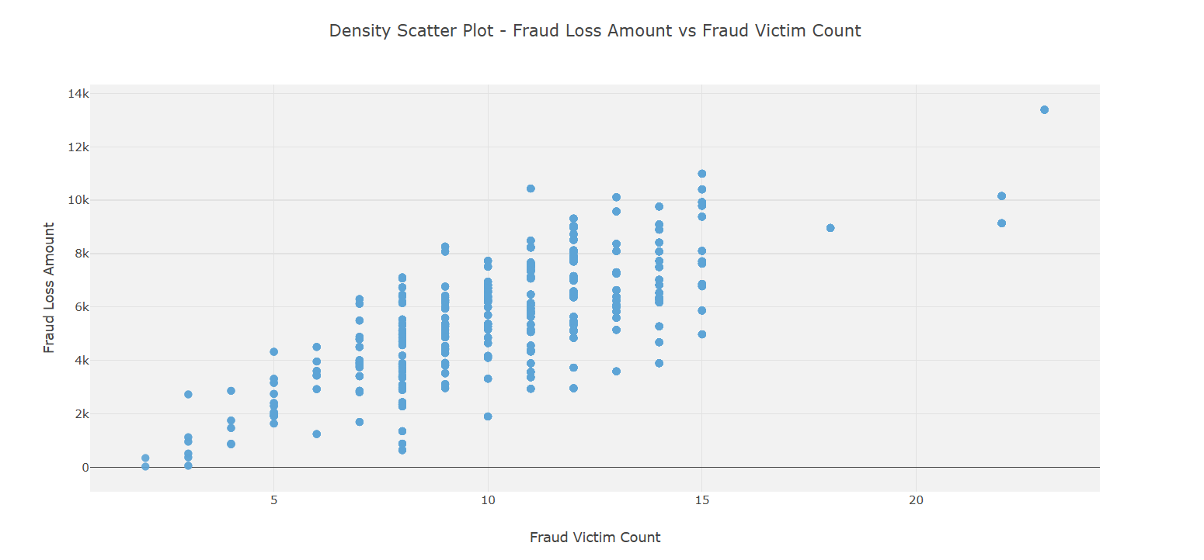
Density Scatter Plot for Fraud Loss Amount and Fraud Victim

Slide 59
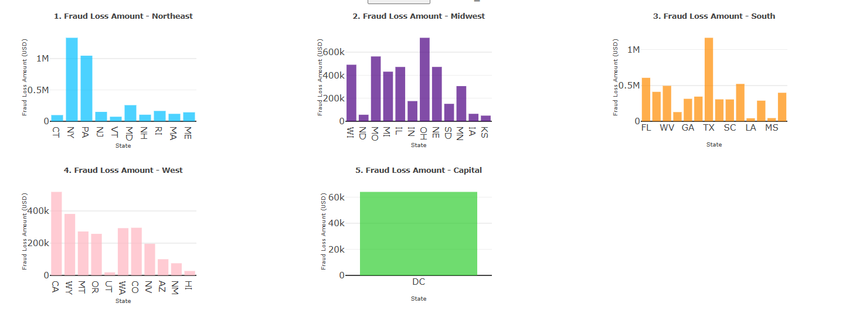
Bar Plot State Category wise representing State Loss in USD

Slide 60
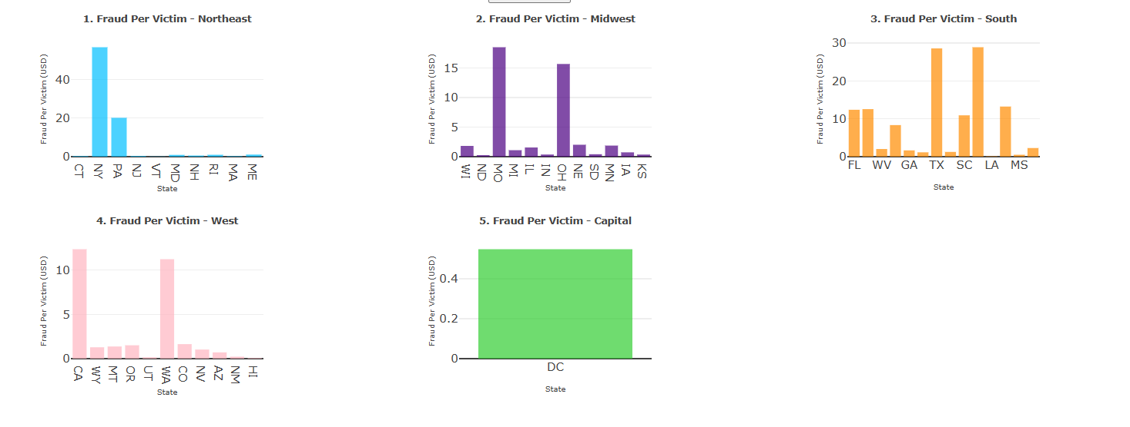
Bar Plot State Category wise representing Fraud per Victim

Slide 61
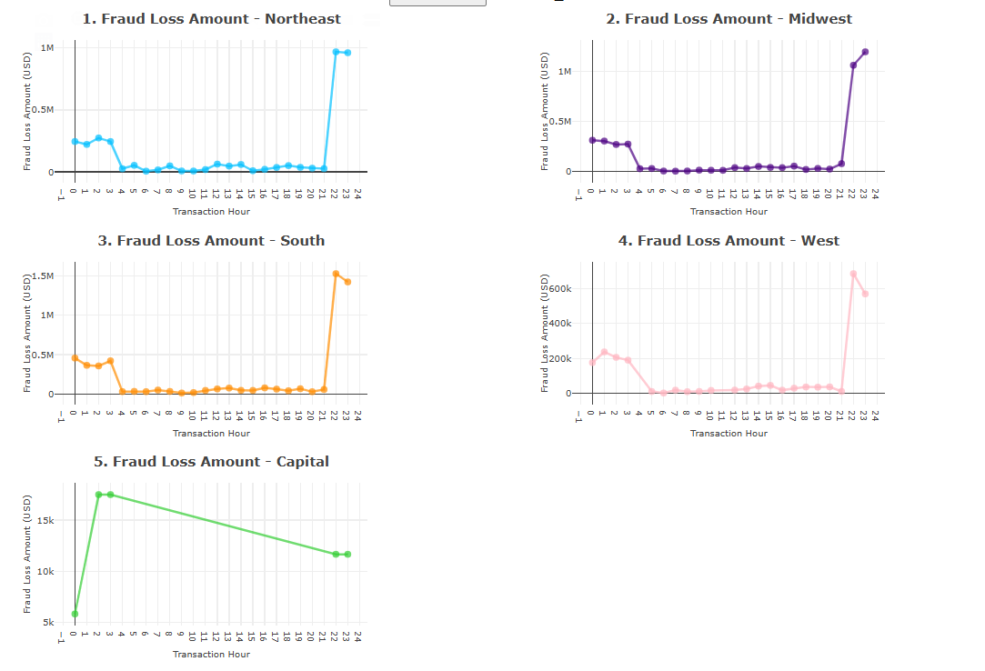
Line Chart for transaction hour representing State Category Loss in USD

Slide 62
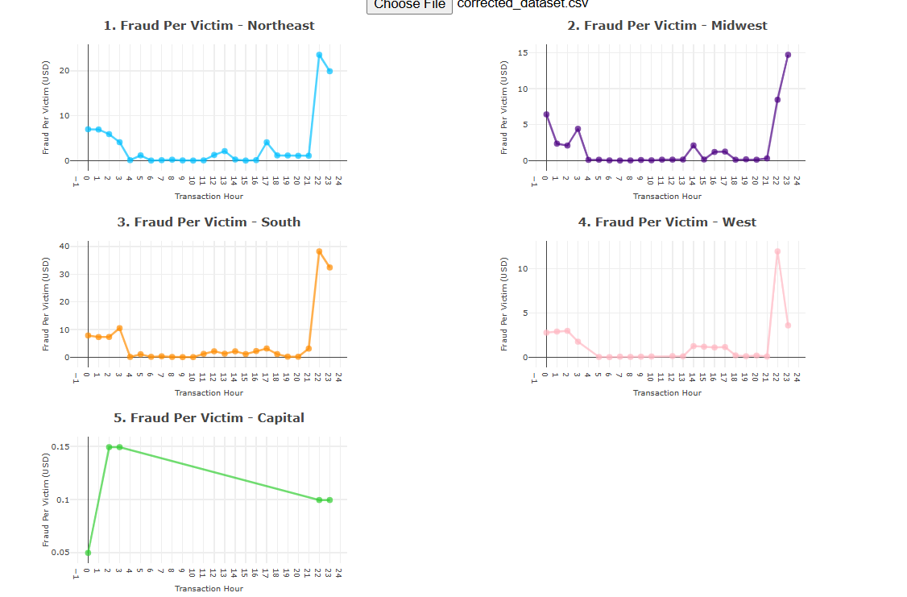
Line Chart for transaction hour representing Fraud Per Victim in USD across all Region

Slide 63
PART 4 - Machine Learning

Slide 66
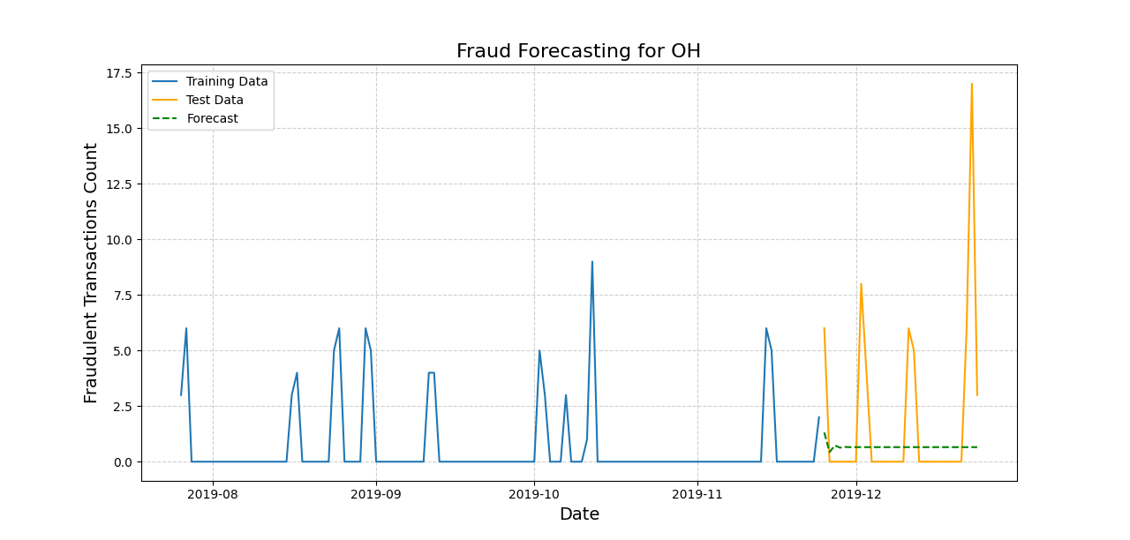
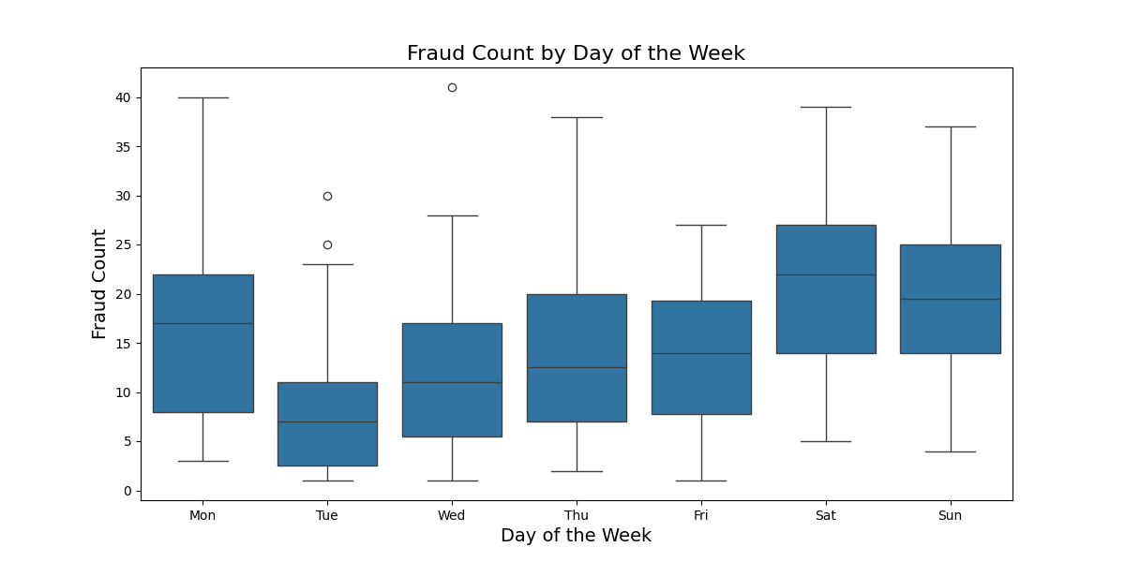

Slide 67
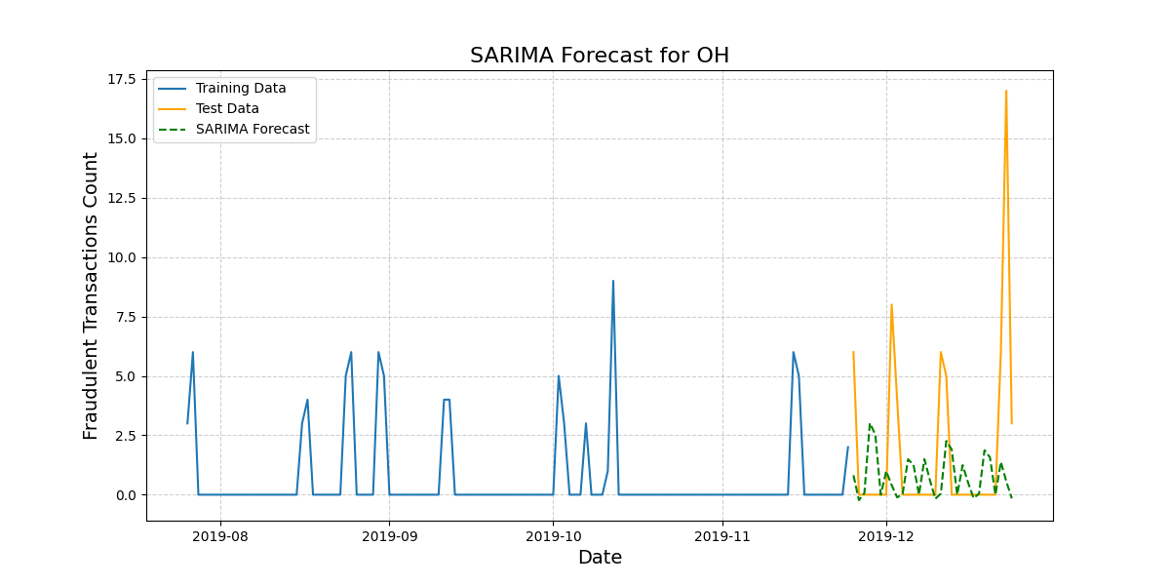


Slide 68



Slide 69



Classification:

Slide 70



Slide 71
Thank You !

